Slide 1
Part 3: The Medium Access Control Sublayer
Reading: Txt, chapter 4.1, 4.2(4.2.1, 4.2.2, 4.2.6), 4.3, 4.4
Notes:
Page <number>

Slide 2
Summary
Part A Functions
The problem
Where are we now?
The Channel Allocation Problem
Part B Dynamic Channel Allocation Technologies
ALOHA Protocols
CSMA
CSMA/CD (old ETHERNET)
Switching (Fast ETHERNET)
Wireless LANS

Slide 3
Part A: Functions
Notes:
Page <number>
Research on DTN, Localization

Slide 4
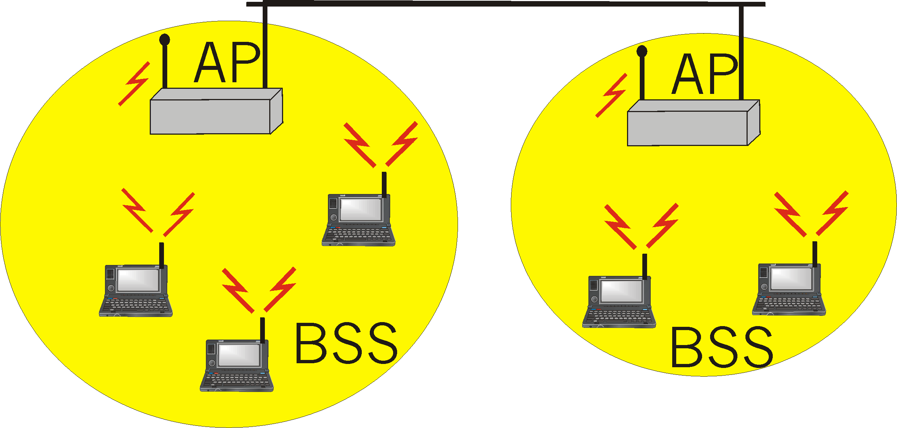
(1)The Problem
The problem: In a single channel broadcast network, when multiple stations try to send messages simultaneously, who has the right to use the channel?
A common sense:
When we take about MAC, we are faced with a broadcast network.
computers
1
2
3
4
5
cable
Notes:
Page <number>
Research on DTN, Localization

Slide 5
(2) Where are we now?
OSI
Application
Presentation
Session
LOGICAL LINK sublayer
Transport
Framing
Error control
Flow control
Network
Data Link
Physical
MEDIA ACCESS sublayer
Transmission/reception of frames

Slide 6
(3) The Channel Allocation Problem
Static
  FDM /TDM (Frequency/Time Division Multiplexing)
    FDM : Radio/TV broadcasts
    TDM : POTS (Plain Old Telephone System)
    GSM uses both (Global System for Mobile Communications)
    Wasteful of bandwidth and not work well for bursty traffic
Dynamic
  Pure/ Slotted ALOHA
  Carrier Sense Multiple Access (CSMA) Protocols
  Collision free protocols (optional contents)

Slide 7
Part B Dynamic Channel Allocation Technologies
ALOHA Protocols
  1.1 Pure ALOHA
  1.2 Slotted ALOHA
CSMA
CSMA/CD (old ETHERNET)
Switching (Fast ETHERNET)
Wireless LANS

Slide 8
1) ALOHA Protocols
The core idea is extremely simple:
Anyone may transmit whenever they want. (Continuous time model.)
Detect if the transmission is successful. (So we need some way for Collision Detection (CD)).
After a collision, wait a random amount of time and transmit the same frame again. This technique is known as backoff.

Slide 9
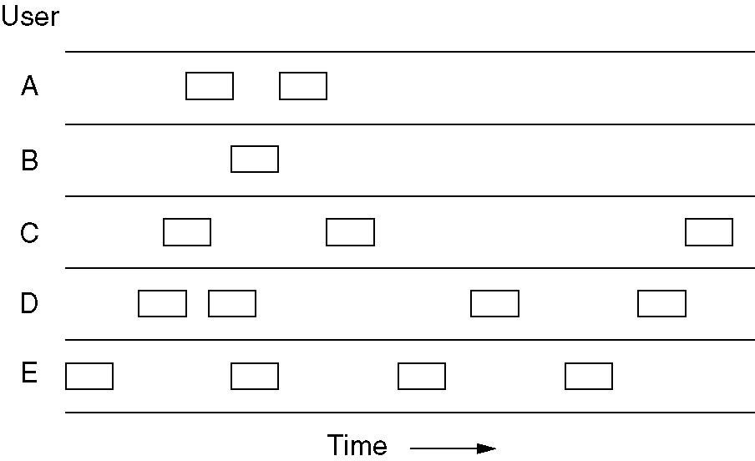
1.1) Pure ALOHA (1)
In pure ALOHA, frames are transmitted at completely arbitrary times.

Slide 10
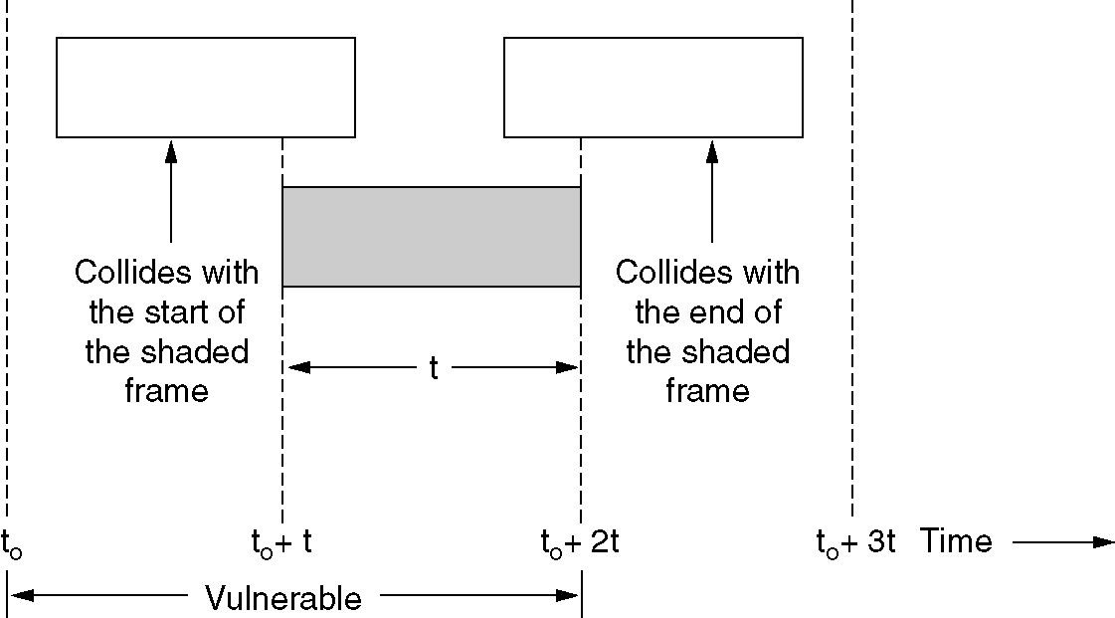
1.1) Pure ALOHA (2)
Vulnerable period for the shaded frame.

Slide 11
1.2) Slotted ALOHA
Time is divided into slots… can only transmit at the start of slot
Vulnerable period halved => max. eff is doubled
Requires sync of clocks
Still poor at hi-loads

Slide 12
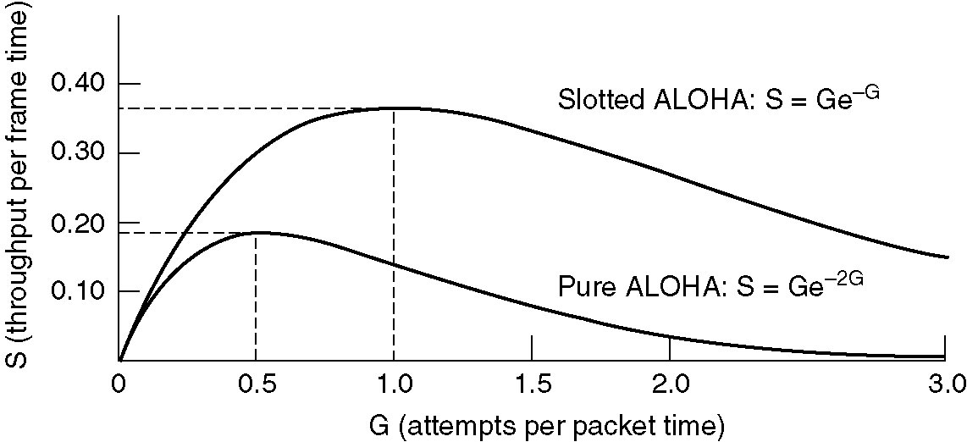
1.2) Slotted ALOHA (2)
Throughput versus offered traffic for ALOHA systems.
Notes:
Page <number>
Examples and detailed mathematical analysis

Slide 13
2) CSMA (Carrier Sense Multiple Access) (1)
Communication Link
We can improve the performance of our simple network greatly if we introduce carrier sensing (CS). With carrier sensing, each host listens to the data being transmitted over the cable.
  A host will only transmit its own frames when it cannot hear any data being transmitted by other hosts.
  When a frame finishes, an interframe gap is allowed to pass before another host starts transmitting its frame.
Notes:
Page <number>
Examples and detailed mathematical analysis

Slide 14
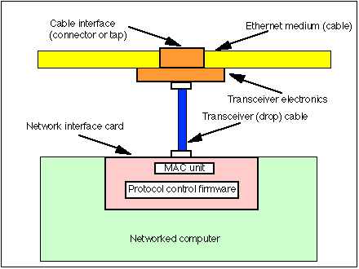
2) CSMA (2)
Improves performance when higher medium utilisation
When a node has data to transmit, the node first listens to the cable (using a transceiver) to see if a carrier (signal) is being transmitted by another node.
Notes:
Page <number>
Examples and detailed mathematical analysis

Slide 15
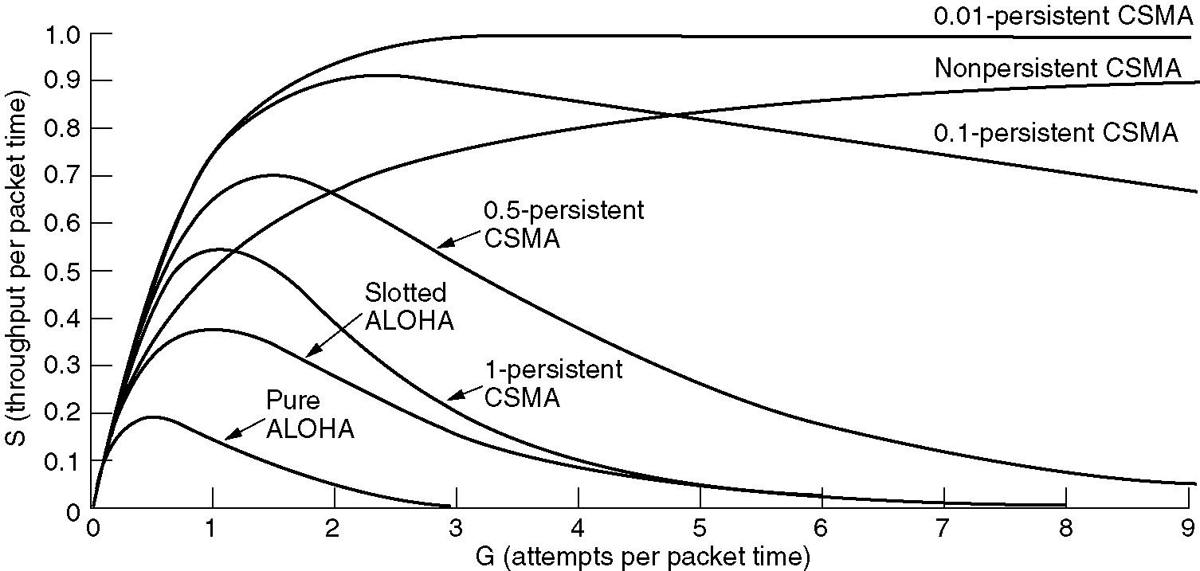
2) CSMA (3): Persistent and Nonpersistent CSMA
Comparison of the channel utilization versus load for various random access protocols.

Slide 16
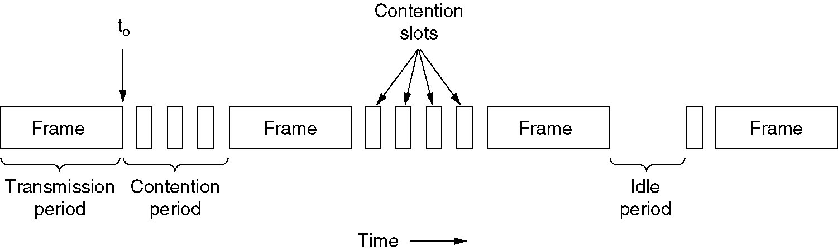
3) CSMA with Collision Detection (CSMA/CD) (1)
CSMA/CD can be in one of three states: contention, transmission, or idle.

Slide 17
3) CSMA/CD (2): IEEE 802.3 Bus LAN
The 802.3 standard describes the operation of the MAC sub-layer in a bus LAN that uses carrier sense, multiple access with collision detection (CSMA/CD).
  Beside carrier sensing, collision detection and the binary exponential back-off algorithm, the standard also describes the format of the frames and the type of encoding used for transmitting frames.
  The minimum length of frames can be varied from network to network. This is important because, depending on the size of the network, the frames must be of a suitable minimum length.
  The standard also makes some suggestions about the type of cabling that should be used for CSMA/CD bus LANs.
The CSMA/CD Bus LAN is also widely called Ethernet.

Slide 18
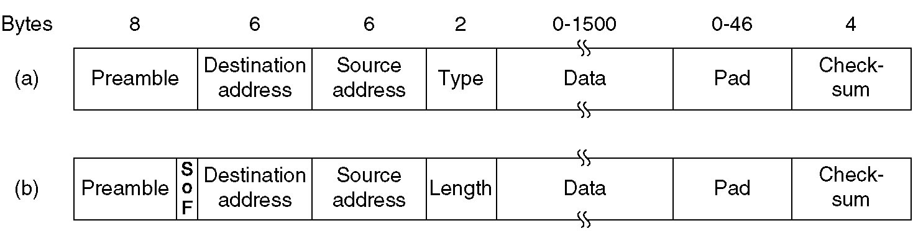
3) CSMA/CD (3): Ethernet MAC Sublayer Protocol
Frame formats. (a) DIX Ethernet,
(b) IEEE 802.3.

Slide 19
3) CSMA/CD (4): Ethernet MAC Sublayer Protocol
Every network card in the world has a unique 46-bit serial number called a MAC address. The IEEE allocates these numbers to network card manufacturers who encode them into the firmware of their cards.
  The destination and source address fields of the MAC frame have 48 bits set aside (the standard also allows for 16-bit addresses but these are rarely used).
  The most significant bit is set to 0 to indicate an ordinary address and 1 to indicate a group address (this is for multicasting, which means that frames are sent to several hosts). If all 48 bits are set to 1 then frames are broadcast to all the hosts.
  If the two most significant bits are both zero then the 46 least significant bits contain the MAC addresses of the source and destination hosts.

Slide 20
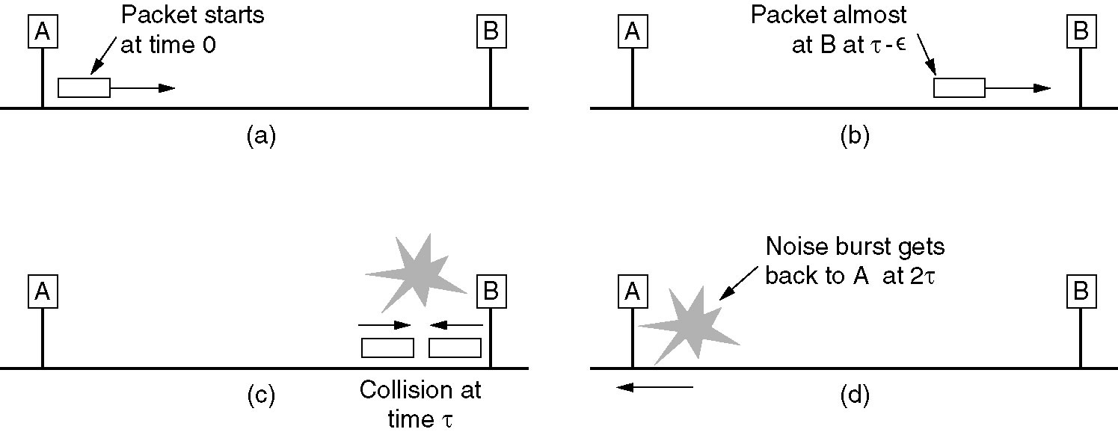
3) CSMA/CD (5): Ethernet MAC Sublayer Protocol (Minimum Frame Length)
When a host transmits a frame, there is a small chance that a collision will occur. The first host to detect a collision transmits a 48-bit jam sequence.
To ensure that any hosts involved with the collision realise that the jam sequence is associate with their frame, they must still be transmitting when the jam sequence arrives. This means that the frame must be of a minimum length.
The worse case scenario is if the two hosts are at far ends of the cable. If host A’s frame is just reaching host B when it begins transmitting, host B will detect the collision first and send a jam signal back to host A.

Slide 21
3) CSMA/CD (6): Ethernet MAC Sublayer Protocol (Minimum Frame Length)
To ensure that no node may completely receive a frame before the transmitting node has finished sending it, Ethernet defines a minimum frame size (i.e. no frame may have less than 46 bytes of payload).
The minimum frame size is related to the distance which the network spans, the type of media being used and the number of repeaters which the signal may have to pass through to reach the furthest part of the LAN.
Together these define a value known as the Ethernet Slot Time, corresponding to 512 bit times at 10 Mbps.

Slide 22
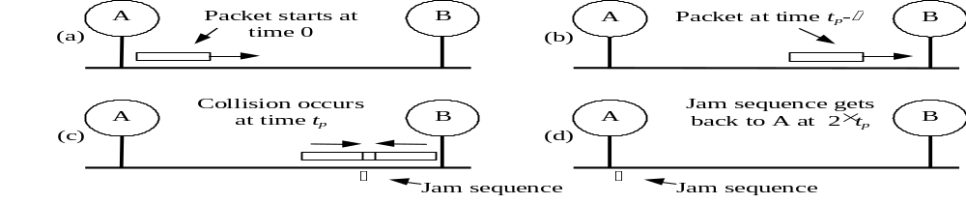
3) CSMA/CD (7): Ethernet MAC Sublayer Protocol (Minimum Frame Length)
The longest time between starting to transmit a frame and receiving the first bit of a jam sequence is twice the propagation delay from one end of the cable to the other.
  This means that a frame must have enough bits to last twice the propagation delay.
  The 802.3 CSMA/CD Bus LAN transmits data at the standard rate of r = 10Mbps.
  The speed of signal propagation is about v = 2×10⁸m/s.

Slide 23



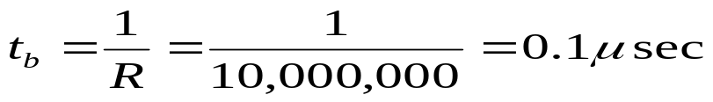
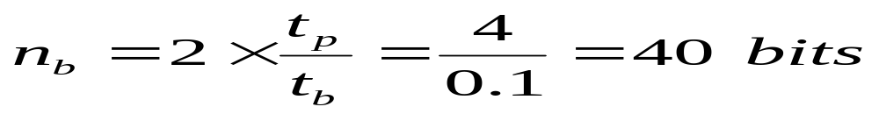
3) CSMA/CD (8): Ethernet MAC Sublayer Protocol (Minimum Frame Length)
Example #1: Cable = 400m, trans. speed = 10 Mbit/sec, propagation speed = 2*10^8 m/sec
A margin of error is usually added to this (often to make it a power of 2) so we might use 64 bits (8 bytes).

Slide 24
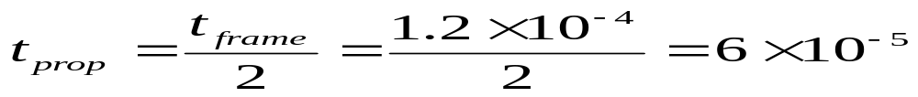
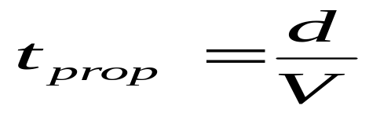
3) CSMA/CD (9): Ethernet MAC Sublayer Protocol (Minimum Frame Length)
Example 2: Speed transmission is 100 Mbits/sec; frame size is 1500 bytes; the propagation speed is 3*10^8 m/sec.
Calculate the distance between the nodes such that the
time to transmit the frame = time to recognize that the collision have occurred.

Slide 25
3) CSMA/CD (10): Ethernet MAC Sublayer Protocol (Minimum Frame Length)
The standard frame length is at least 512 bits (64 bytes) long, which is much longer than our minimum requirement of 64 bits (8 bytes).
  We only have to start worrying when the LAN reaches lengths of more than 2.5km.
802.3 CSMA/CD bus LANs longer than 500m are usually composed of multiple segments joined by in-line passive repeaters, which output on one cable the signals received on another cable.
  When we work out the minimum frame length for these longer LANs, we also have to take the delays caused by the passive repeaters (about 2.5μsec each) into account as well.

Slide 26
3) CSMA/CD (11): Ethernet MAC Sublayer Protocol (Shortest Ethernet Frame)
Why specify a shortest frame of 64byte?
64 bytes sent at 10Mbps ⇒ 51.2μsec
500m/segment, 4 repeaters between nodes ⇒2500m ⇒25 μsec propagation delay
The frame should be longer enough for sender to detect the collision(2x25 or about 50 μsec )
Node A
R1
R2
R3
R4
Node B
500m ⇒25 μsec propagation delay

Slide 27
3) CSMA/CD (12): Ethernet MAC Sublayer Protocol (Non-Deterministic)
The 802.3 CSMA/CD bus LAN is said to be a non-deterministic network. This means that no host is guaranteed to be able to send its frame within a reasonable time (just a good probability of doing so).
  When the network is busy, the number of collisions rises dramatically and it may become very difficult for any hosts to transmit their frames.
A real-time computing application (such as an assembly line) will demand that data is transmitted within a specified time period.
  Since the 802.3 bus LAN cannot guarantee this, its use for real-time applications may not only be undesirable but potentially dangerous in some situations.
Notes:
Page <number>
Examples

Slide 28
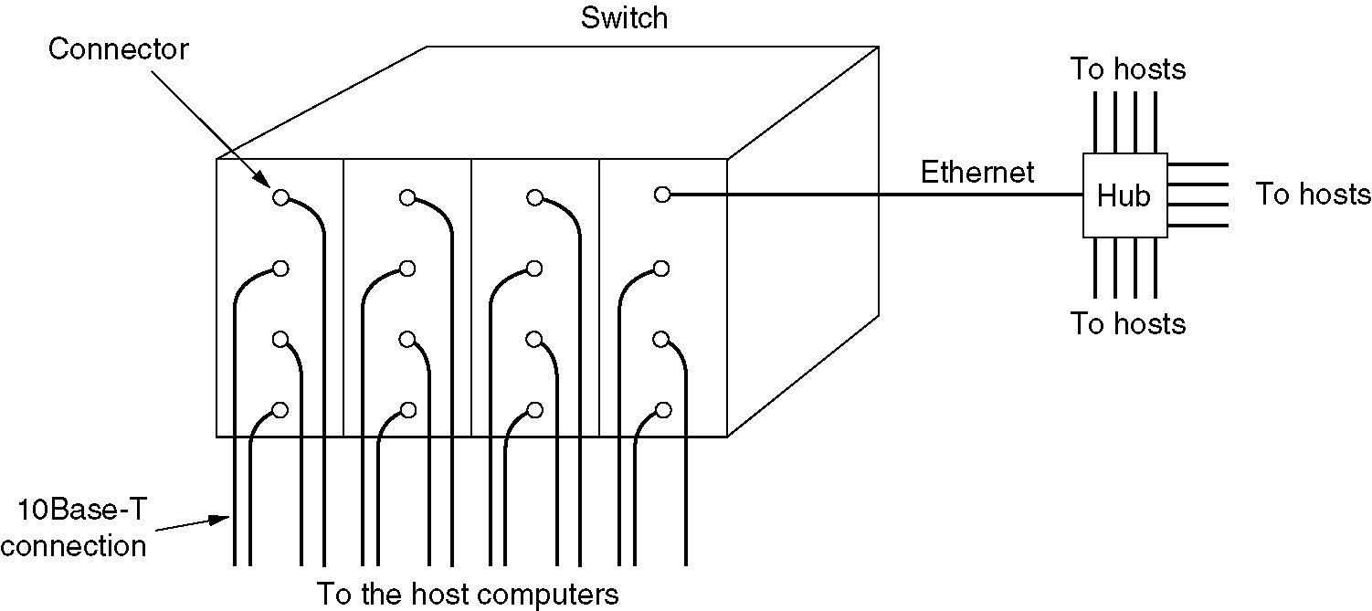
4) Switched Ethernet
A simple example of switched Ethernet.
Notes:
Page <number>
More Contents are provided in separate slides

Slide 29
5) Wireless LANs
5.1 RF allocation
5.2 The 802.11 Protocol Stack
5.3 The 802.11 MAC Sublayer Protocol
5.4 The 802.11 Frame Structure

Slide 30
5.1) Where Does Wireless RF Live?
ISM Band: Industrial, Scientific, Medical
902-928 MHz
2400-2483.5 MHz
5725-5850 MHz
Old Wireless
802.11/802.11b
802.11a
Bluetooth
Cordless Phones
Home RF
Baby Monitors
Microwave Ovens

Slide 31
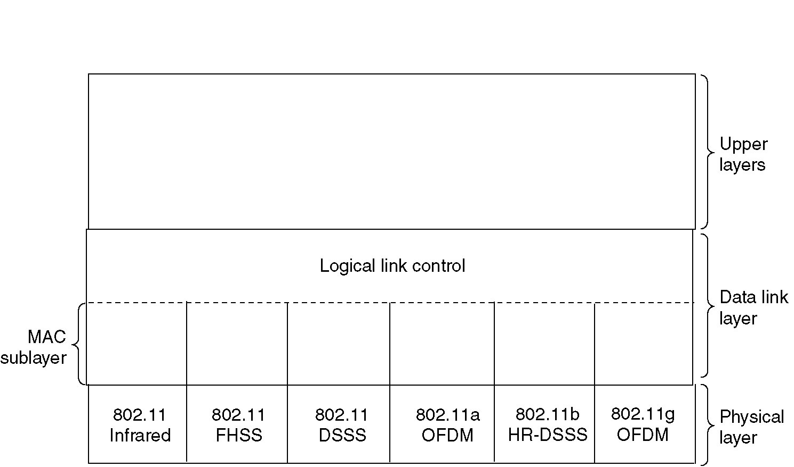
5.2) The 802.11 Protocol Stack
Part of the 802.11 protocol stack.

Slide 32
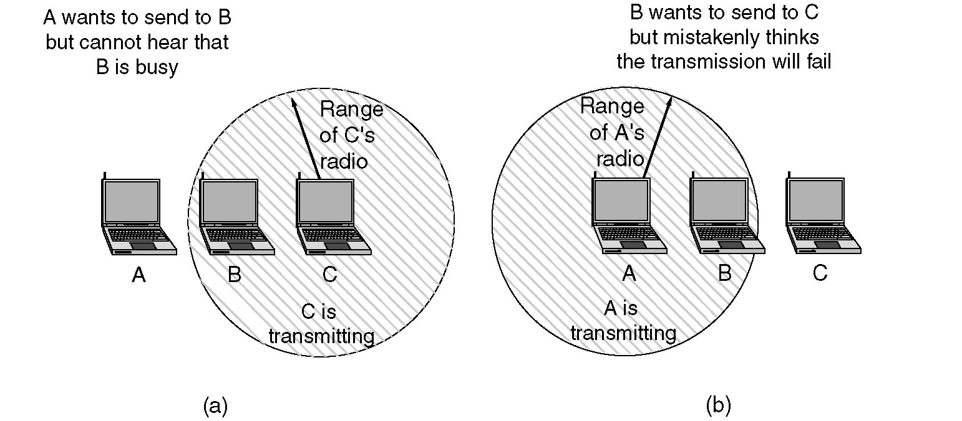
5.3) The 802.11 MAC Sublayer Protocol (1)
(a) The hidden station problem.
(b) The exposed station problem.

Slide 33
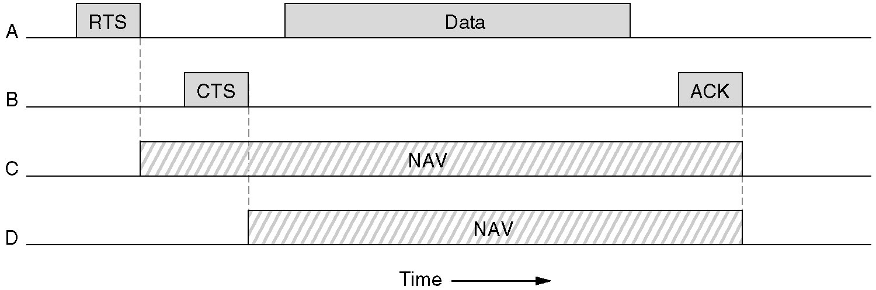
5.3) The 802.11 MAC Sublayer Protocol (2)
The use of virtual channel sensing using CSMA/CA.

Slide 34
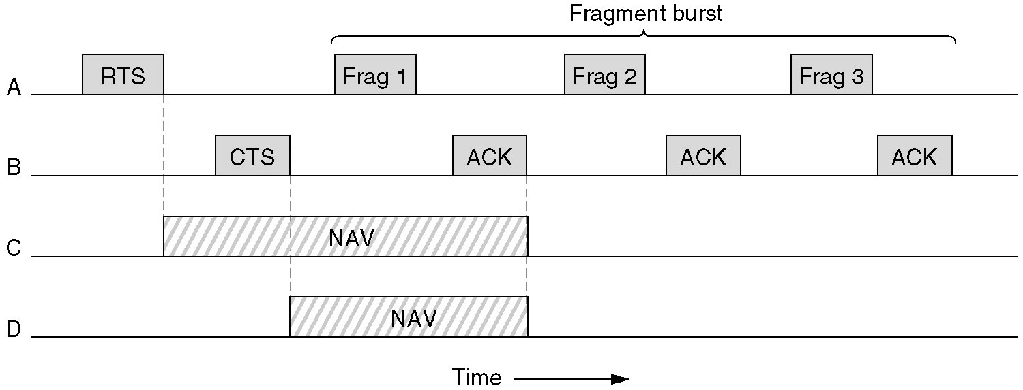
5.3) The 802.11 MAC Sublayer Protocol (3)
A fragment burst.

Slide 35
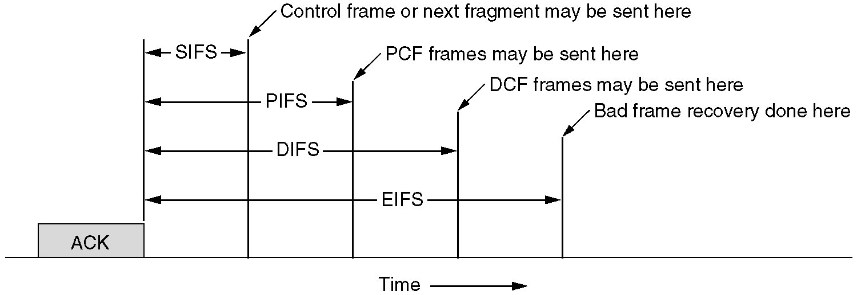
5.3) The 802.11 MAC Sublayer Protocol (4)
Interframe spacing in 802.11.

Slide 36
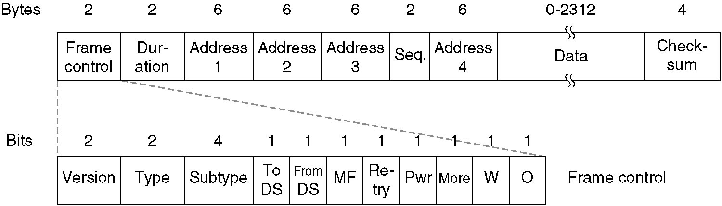
5.4) The 802.11 Frame Structure
The 802.11 data frame.

